Slide 1
MEKON/HOBO Introductory Tutorial
[Under Construction]

Slide 2
Tutorial Generalities
Based on:
HOBO/MEKON demo model
MEKON Model Explorer
Provides:
Introduction to MEKON Model Explorer
Overview of MEKON + HOBO models
+ Associated functionality
Specific model-instantiation examples
+ Explanations of functionalities invoked

Slide 3
Tutorial Pre-Conditions
Basic familiarity with:
Frames-based knowledge representation
OWL + Description Logics
Accessed MEKON project website (*)
Viewed general introductory material
Checked-out all code and resources
Built all code and resources
Preferably using ANT build script provided
* https://code.google.com/p/mekon

Slide 4
Tutorial Content
Using MEKON Model Explorer to:
Browse of model:
Basic MEKON version of model
Hybrid HOBO/MEKON version of model
Manipulate model-instantiations:
Creating + storing “assertion” instantiations
Creating + executing “query” instantiations

Slide 5
Tutorial Format
Actions:
The tutorial describes a series of actions to be performed via the MEKON Model Explorer (ME)
The action descriptions come with screenshots showing either the actions being performed, or the results of the actions having occurred
Explanations:
Explanations are provide concerning the functionalities being displayed as the actions are performed
Interspersed throughout the tutorial are more general explanations, not specifically linked to the actions on particular slides, but more generally applicable to various actions on previous and/or subsequent slides
Icons:
The semantics of the ME icons are summarised at the start of the tutorial (a similar glossary can also be obtained via the ME “Help” button)
Recaps are provided throughout for specific icons as they are introduced
The semantics of specific icon modifiers are also provided at the relevant points

Slide 6
1. Browsing Basic MEKON Version of Model

Slide 7
MEKON Models
MEKON provides representational entities operating at three distinct levels: concept-level, instance-level and meta-level.
Concept-Level : Representation of domain model
CFrame: Domain concept
CNumber: Numeric-value definition (numeric-type + valid value-range)
CValue: Concept-level value-entity (CFrame or CNumber)
CSlot: Inter-concept relationships OR numerical attribute of concept
Instance-Level: Representation of specific instantiations of domain model
IFrame: Instantiation of domain concept
INumber: Specific numeric value
IValue: Instance-level value-entity (IFrame or INumber)
ISlot: Inter-instance relationships OR numerical attribute value
Meta-Level: Representation of references to domain model
MFrame: Reference to domain concept (used solely for defining value-types of CFrame-valued slots)

Slide 8
Icon Summary
Shapes (all relevant colours)
Entity Category
Entity Level
Icon Shape
Value Entity (*)
Meta
Value Entity (*)
Concept
Value Entity (*)
Instance
Slot
Concept / Instance
* Frame OR Number
Colours (all relevant shapes)
Entity Category
Entity Source
Icon Colour(s)
Frame/Slot
Internal (*)
Frame/Slot
External (**)
Frame/Slot
Internal AND External
Number
ANY
* Derived from Object Model
** In the case of demo model, derived from OWL ontology

Slide 9
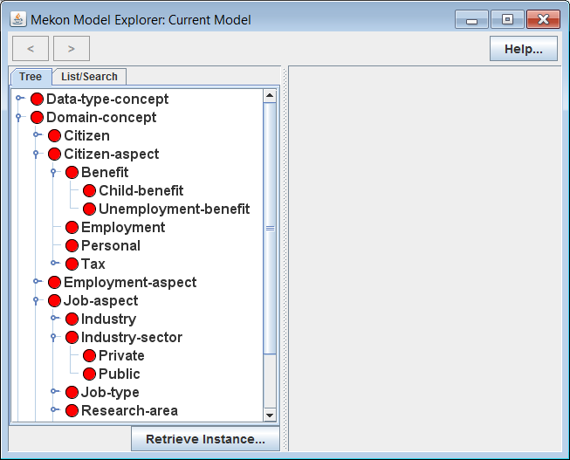
Actions:
Invoke ME with basic MEKON frames model (FM) version of demo model
Open-up and explore tree in LH panel
Explanation:
Tree represents hierarchy of all concept-level frames, or CFrames, in model.
Model consists of this set of CFrames, together with associated sets of concept-level slots , or CSlots (not currently visible)
Icons Recap:
CFrame / external source only

Slide 10
MEKON Model Building
Basic MEKON frames models are derived entirely from one or more external sources, typically of an ontology like nature. This contrasts to hybrid HOBO/ MEKON models, in which part of the frames model is derived from a HOBO-based object model.
MEKON-OWL Model Builder Plug-in: In the case of the demo model, the basic version of the model is built from an OWL ontology by the standard plug-in. This plug-in uses some fairly obvious mappings, such as:
OWL class → CFrame
Existential property restriction → CSlot
Etc.
MEKON Configuration File: This file directs the entire model building process, specifying the relevant model-building plug-in(s), and any required reasoning plug-ins to be attached (such as the MEKON-OWL reasoning plug-in), and providing the required configuration information for each.
The same file is also used to specify the object model for HOBO/MEKON models, and any bindings between it and the externally derived sections of the model.

Slide 11
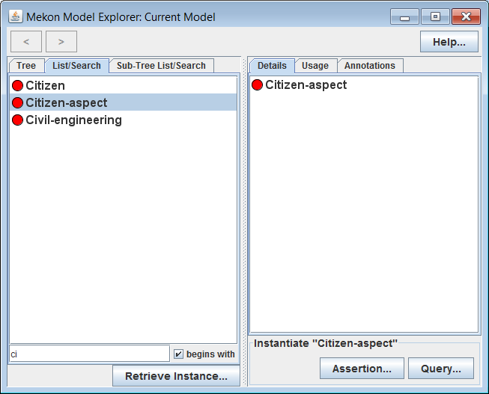
Actions:
Select various CFrames in LH panel, including some with sub-frames
Select “List Search” tab in LH panel
Filter resulting CFrames list by typing into text-box
Select specific CFrames from resulting lists
Explanation:
Details of selected CFrames appear in RH panel (to be explained in subsequent slides)
“Sub-Tree List Search” tab appears when any CFrame with descendants is selected, containing list consisting only of descendants of selected CFrame

Slide 12
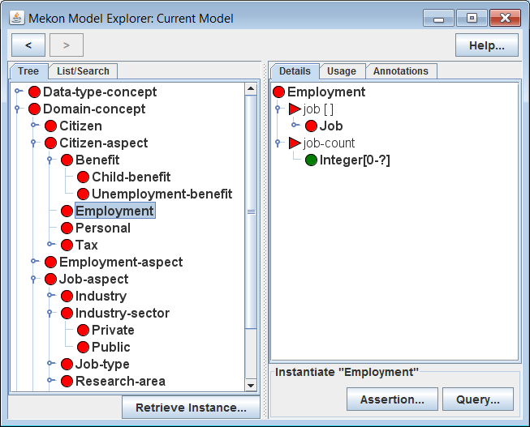
Actions:
Select “Employment” CFrame in LH panel (via any of the three tabs)
Explanation:
Details of “Employment” CFrame appear in RH panel, including details of two attached slots:
“job”: IFrame-valued slot (values must be instantiations of the “Job” CFrame)
“job-count”: Integer-valued slot (value-type is a CNumber, specifying valid INumber values)
Icons Recap:
CSlot / External source only
CNumber / Source(s) as for parent-slot

Slide 13
Slot Specification
Value-Types: Each CSlot provides a value-type, which defines the valid values for the instantiating ISlots. Value-types are represented via entities from the level above that of the values that the ISlot will have:
Possible slot value-types are:
MFrame: Defines CFrame-valued ISlot
CFrame: Defines IFrame-valued ISlot
CNumber: Defines INumber-valued ISlot
Fixed Values: A CFrame can provide sets of “fixed-values” for instantiations of specific CSlots on either the CFrame itself or on any of it’s ancestors.
When the relevant CSlots are instantiated, along with the CFrame, any such values will be automatically added to the instantiating ISlots.
Note: Fixed-values can only be defined for CFrame-valued and INumber-valued slots. They are not applicable to IFrame-valued slots.
(See later slides in this section for examples of fixed-values.)

Slide 14
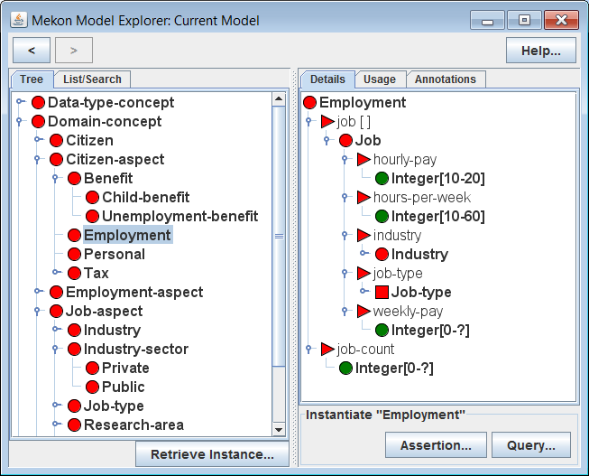
Actions:
Recursively expand section of tree under “Job” CFrame representing value-type of “job” slot in RH panel
Explanation:
Details of “Job”, along with all other CFrames representing slot value-types, are recursively displayed in RH panel
Displayed details include details of both slots and descendant CFrames
Value-type of “jobType” slot is a meta-level frame, or MFrame, rather than a CFrame. Hence the values for that slot will be CFrames rather than IFrames
Icons Recap:
MFrame / External source only

Slide 15
Model Instantiations
A specific model-instantiation is represented via an appropriate IFrame/ ISlot network, with the IFrames and ISlots being instantiations of the relevant CFrames and CSlots.
Instantiation Initialisation: When a CFrame is instantiated as an IFrame, the IFrame is initialised as follows:
All CSlots on the CFrame, and on any ancestor CFrames, are instantiated as ISlots, and attached to the IFrame. Where there is more than one such CSlot for a particular property, then a single ISlot is created whose value-type is the intersection of the value-types of all contributing CSlots.
All fixed-values on the CFrame, and on any ancestor CFrames, are added to the ISlots.

Slide 16
Actions:
Navigate backwards and forwards through previous selections using “<“ and “>” arrows in top left of GUI
Select any CFrame in the RH panel to update selection in LH panel (and hence to update displayed details in RH panel)

Slide 17
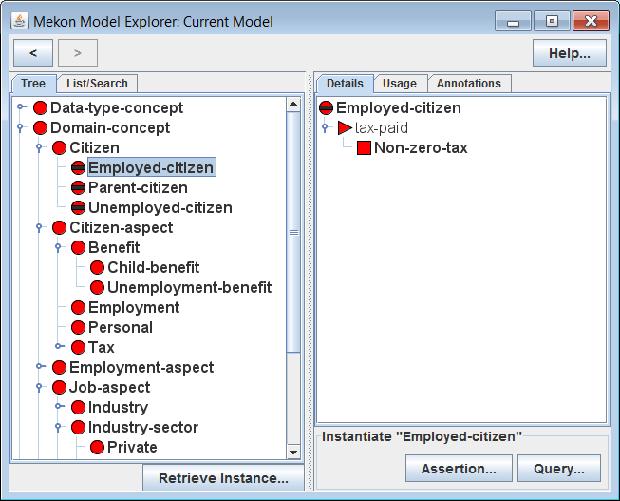
Actions:
Select “Employed-Citizen“ CFrame in LH panel
Explanation:
“Employed-Citizen” is a hidden CFrame, which means that it cannot be instantiated, though it can play a role in the automatic updating of instantiations
If an IFrame instantiating “Citizen” is inferred (*) to be an instance of “Employed-Citizen” , then the value-type of the “tax-paid” slot on that IFrame will be automatically updated, from the default value, “Tax”, as provided by “Citizen”, to the more specific “Non-zero-tax”, as provided by “Employed-Citizen”
* See next slide for further explanation of IFrame updating via OWL-based reasoning
Icon Modifier:
CFrame is hidden frame

Slide 18
Instantiation Updating
As the state of an instantiation (i.e. an IFrame/ ISlot network) is updated, additional updates may be automatically provided by appropriate reasoning plug-ins. In the case of the demo-model, this means the MEKON-OWL reasoning plug-in.
MEKON-OWL Reasoning Plug-in: Performs automatic instantiation updating as follows:
An OWL version of the IFrame/ISlot network is created: a class-expression if the network is a tree, a collection of individuals otherwise
The DL reasoner is invoked to find all inferred super-classes or inferred types of this OWL version
The corresponding CFrames are found, and the associated CSlots and fixed-values used to dynamically update the ISlots on the root IFrame of the instantiation

Slide 19
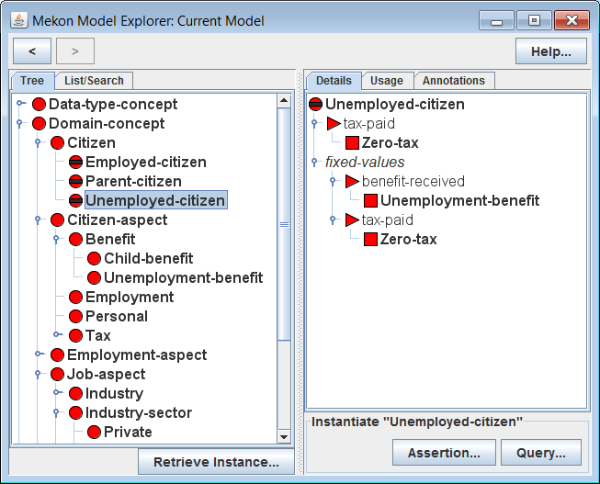
Actions:
Select Unemployed-Citizen CFrame in LH panel
Explanation:
“Unemployed-Citizen,” similarly to Employed-”Citizen”, provides a specialisation of the value-type for the “tax-paid” slot
It also provides fixed-values for both that slot and the “benefit-received” slot, representing actual values that will be assigned to the relevant ISlots whenever an IFrame is classified accordingly.
Hence if an IFrame instantiating “Citizen” is classified as an instance of “Unemployed-Citizen”, then not only will the “tax-paid” ISlot be given a specialised value-type of “Zero-tax”, it will also be assigned an actual value of “Zero-tax.” Similarly the “benefit-received” ISlot will be assigned a value of “Unemployment-Benefit”

Slide 20
2. Browsing Hybrid HOBO/MEKON Version of Model

Slide 21
HOBO Models
The HOBO framework provides the following:
Generic Java classes for creating domain-specific object models (OM)
Mechanisms for associating HOBO OMs with appropriate MEKON frames models (FM)
OM/FM Association Mechanisms:
These mechanisms consist of:
OM → External-Source Mapping Creation of associations between selected OM entities and FM entities derived from external sources, such as ontologies (with mappings specified via the HOBO configuration file – see later slides)
FM Entity Generation: Generation of new FM entities for all non-mapped OM entities
OM ←→ FM Binding: Managing “bindings” between all OM entities and their corresponding FM entities, ensuring that any relevant operations initiated in either representation will be reflected by corresponding operations occurring in the other

Slide 22
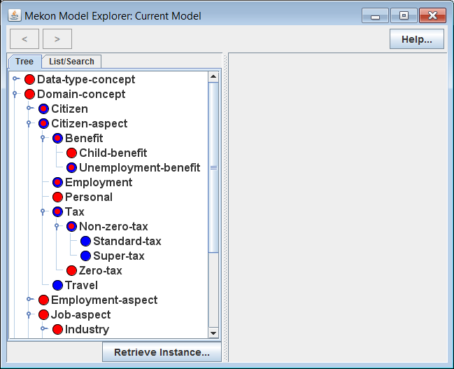
Actions:
Invoke ME with hybrid HOBO/MEKON, object model (OM) /frames model (FM) version of demo model
Open-up and explore tree in LH panel
Icons Recap:
CFrame / Internal source only
CFrame / Internal + external sources

Slide 23
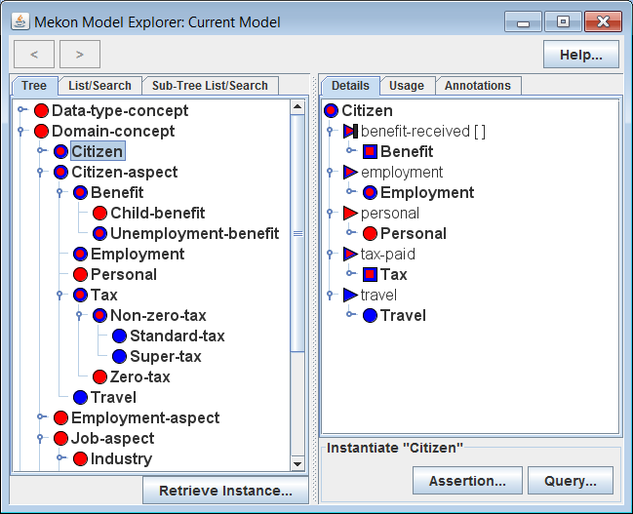
Actions:
Select “Citizen” CFrame in LH panel
Icons Recap:
MFrame / Internal + external sources
Icon Modifier:
CSlot / Internal source only
CSlot is a derived slot
CSlot / Internal + external sources

